Slide 1

OTAN Resources

Slide 2

Welcome to Chapter 5!
Adopting Models that Work

Slide 3
Session Objectives
Articulate the key considerations and challenges when implementing digital learning models in adult education
Apply strategies and digital tools to design an inclusive and accessible digital learning experience that addresses diverse learners' needs
Notes:
🕧 = 1 minute
Welcome the group to the session on adopting models that work.
📄Reference to DLG*. Today’s session and activity are tied to Chapter 5 of the Digital Learning Guidance, which is published as a PDF on the OTAN site alongside a self-paced course in Canvas where you can explore these ideas in more depth.
Introduce today’s focus = understanding and implementing effective digital learning models
Review today’s objectives:
Articulate the key considerations and challenges when implementing digital learning models in adult education.
Apply strategies and digital tools to design an inclusive and accessible digital learning experience that addresses diverse learners' needs
By the end of this session, the group will have explored strategies for using digital learning models to help adult learners overcome common challenges and barriers to engaging with training programs.
Links
DLG: https://otan.us/Content/Documents/Resources/dlg/ca_adult-learning-guide_081822-a11y.pdf#page=78

Slide 4





Session Agenda
Warm-up with "Two truths and a digital lie"
Explore effective digital learning models
Apply digital learning models to common scenarios
Discuss digital learning tools and models
Explore next steps
Notes:
🕧 = 1 minute
Provide an overview of the agenda, which includes a warm-up activity, group discussion, an opportunity to apply key concepts, and a short reflection

Slide 5

Warm-Up Activity
Two Truths and a Digital Lie
Share two true statements and one false statement about your experiences with digital learning.
Visit the link below to submit your response:
<Insert link or code here>
Notes:
🕧 = 5 minutes
💻 Create an online polling environment using Mentimeter* or Poll Everywhere*
Insert the link in the slide and paste it here for easy reference
🗣️ Facilitation tip. Here’s a short tutorial for Mentimeter* and Poll Everywhere* to help guide the creation of the online poll
Instruct participants to share two true statements and one false statement about their experiences with digital learning.
For example, a participant might share:
"I have been using digital learning tools for five years." (Truth)
"I have designed an entire online course." (Truth)
"I can code in three different programming languages." (Lie)
As the facilitator, ask participants to identify the statements that seem to be a lie.
When a lie is correctly identified, the person that submitted the statement can then identity their two truths and talk a little about the context surrounding each statement shared.
The goals of this activity are to:
Have fun
Get to know each other
Model use of digital polling tools
And give participants a chance to get to know each other’s experience with digital tools
Links
Mentimeter: https://www.mentimeter.com/
Mentimeter Tutorial: https://www.mentimeter.com/how-to
Poll Everywhere: https://www.polleverywhere.com/
Poll Everywhere Tutorial: https://www.polleverywhere.com/videos/tutorials/creating-polls

Slide 6
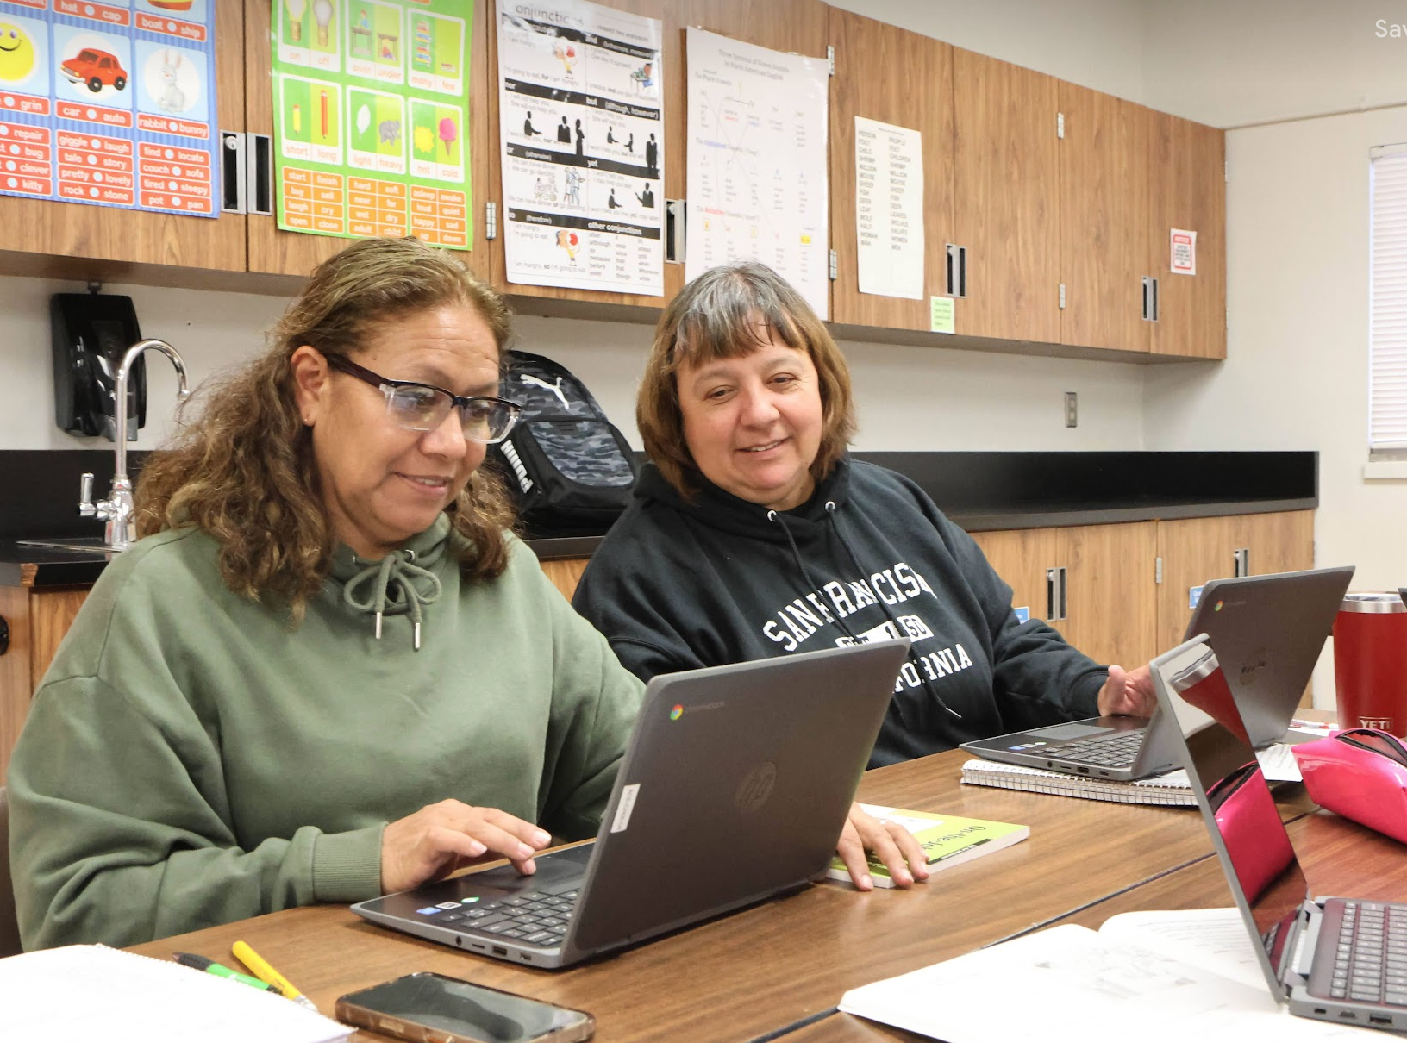
Digital Learning Models
Digital Learning Models
Distance
Blended
HyFlex
Notes:
🕧 = 2-3 minutes
Provide a brief overview of each model.
This is a facilitator-led portion of the session where a definition and brief discussion of each model is provided.
Distance: Distance education encompasses any learning that occurs away from a traditional classroom, including online learning.
Blended: Blended learning combines in-person and online instruction, offering an element of learner control over time, place, path, and pace.
HyFlex: The HyFlex model provides learners the flexibility to choose their mode of participation—online or in-person, synchronous or asynchronous.
🗣️ Facilitation tip. Depending on the audience, consider asking which models each teacher and/or program has used, is currently using, and/or plans to use moving forward. This will give participants a chance to connect with each other based on current/future plans.

Slide 7
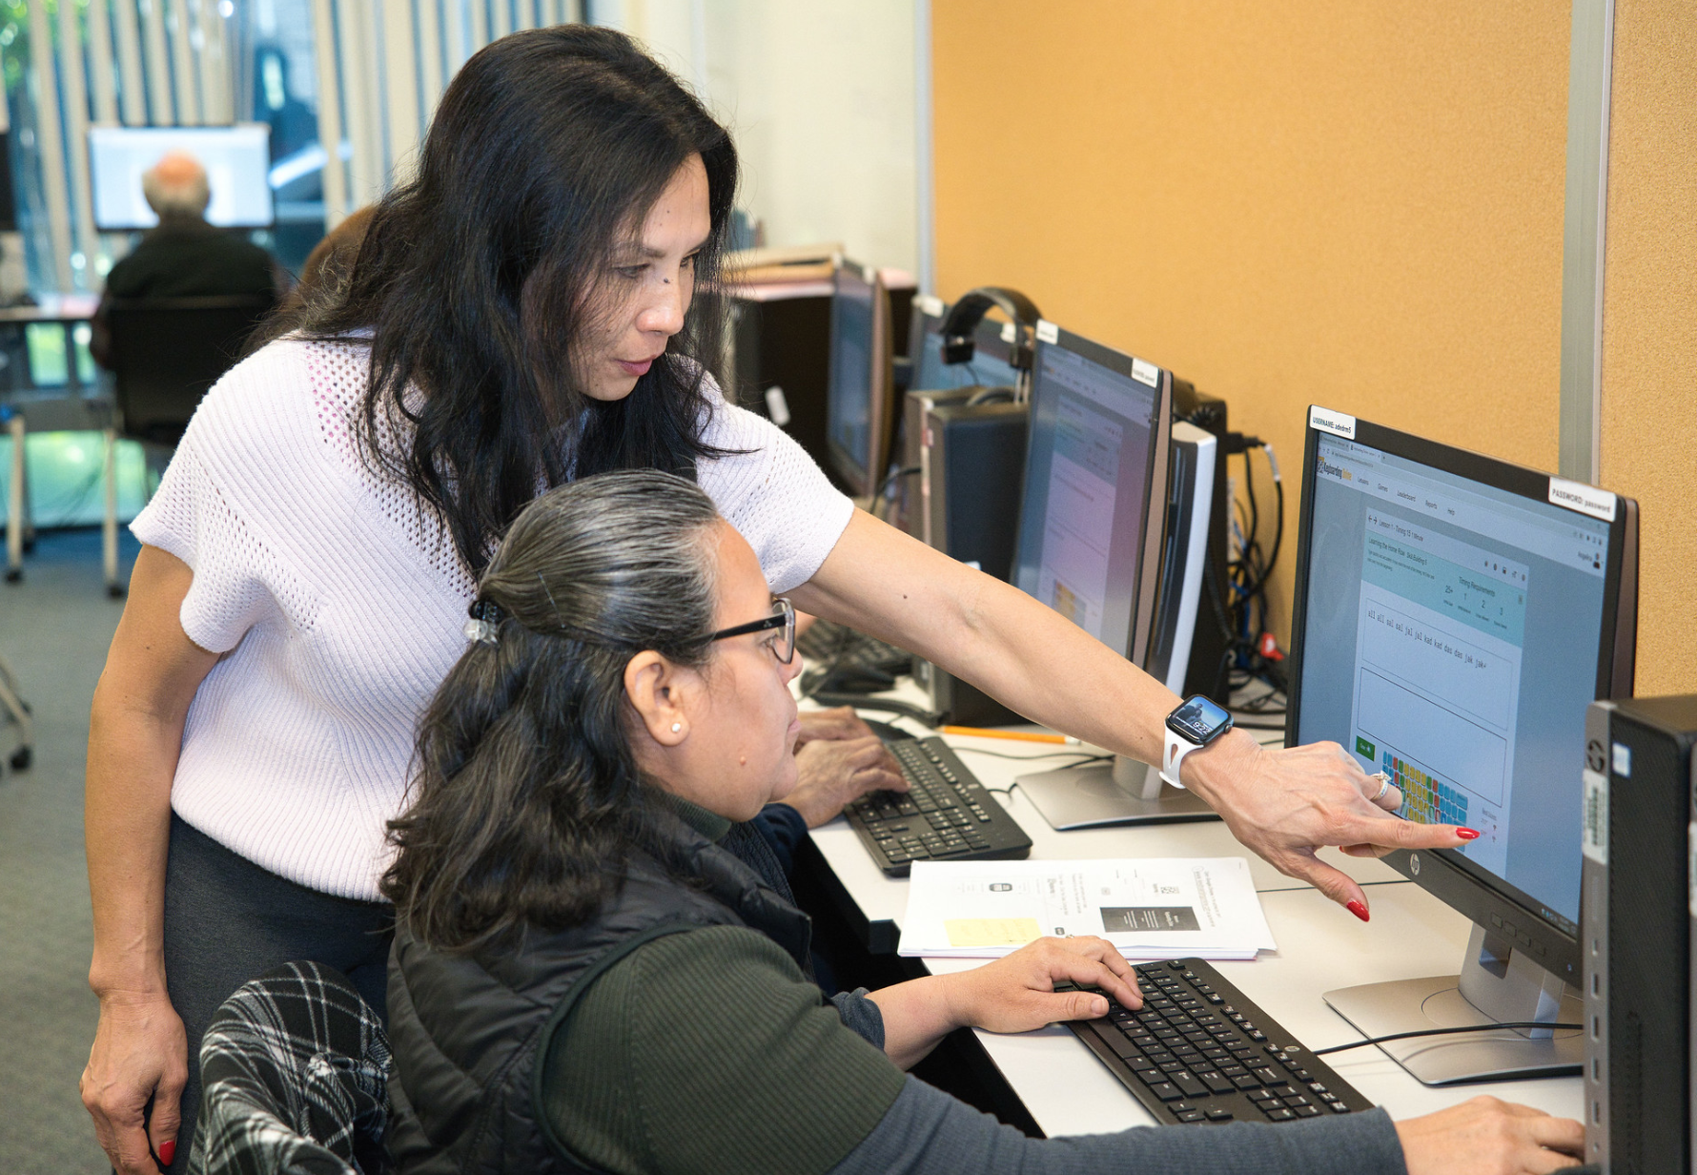
Implementing Digital Learning Models
Think-Pair-Share
What’s the primary challenge you’ve encountered while implementing digital learning (that can reasonably be solved)?
“Digital learning” can be:
Fully distance
Blended
HyFlex
Notes:
🕧 = 5 minutes
Instruct participants to talk with their neighbor about their primary challenges in using technology in the classroom.
This could be any form of digital learning, including fully online, blended, etc.
🗣️ Facilitation tip. Encourage participants to focus on challenges that can reasonably be solved (i.e. building effective lesson plans is a reasonable challenge; addressing the fact that students often have shifting work schedules and the related impact on retention may not be a reasonable challenge to solve).
After groups have had a few minutes to talk, bring the group back together.
Ask volunteers to highlight key themes or topics that were discussed in the group.
🗣️ Facilitation tip. You can highlight interesting themes that seem to surface across each group conversation. A few ideas for what this can look like include:
"I'm noticing a recurring theme of... can anyone share more about that experience?”
"Several of you have mentioned challenges with..., let's dig deeper into potential solutions for that.”
"Digital literacy seems to be a common hurdle, how have you incorporated digital literacy training into your learning models?"
"I've heard a few mentions of balancing synchronous and asynchronous learning. Could someone elaborate on how they've managed this in their own practice?"

Slide 8
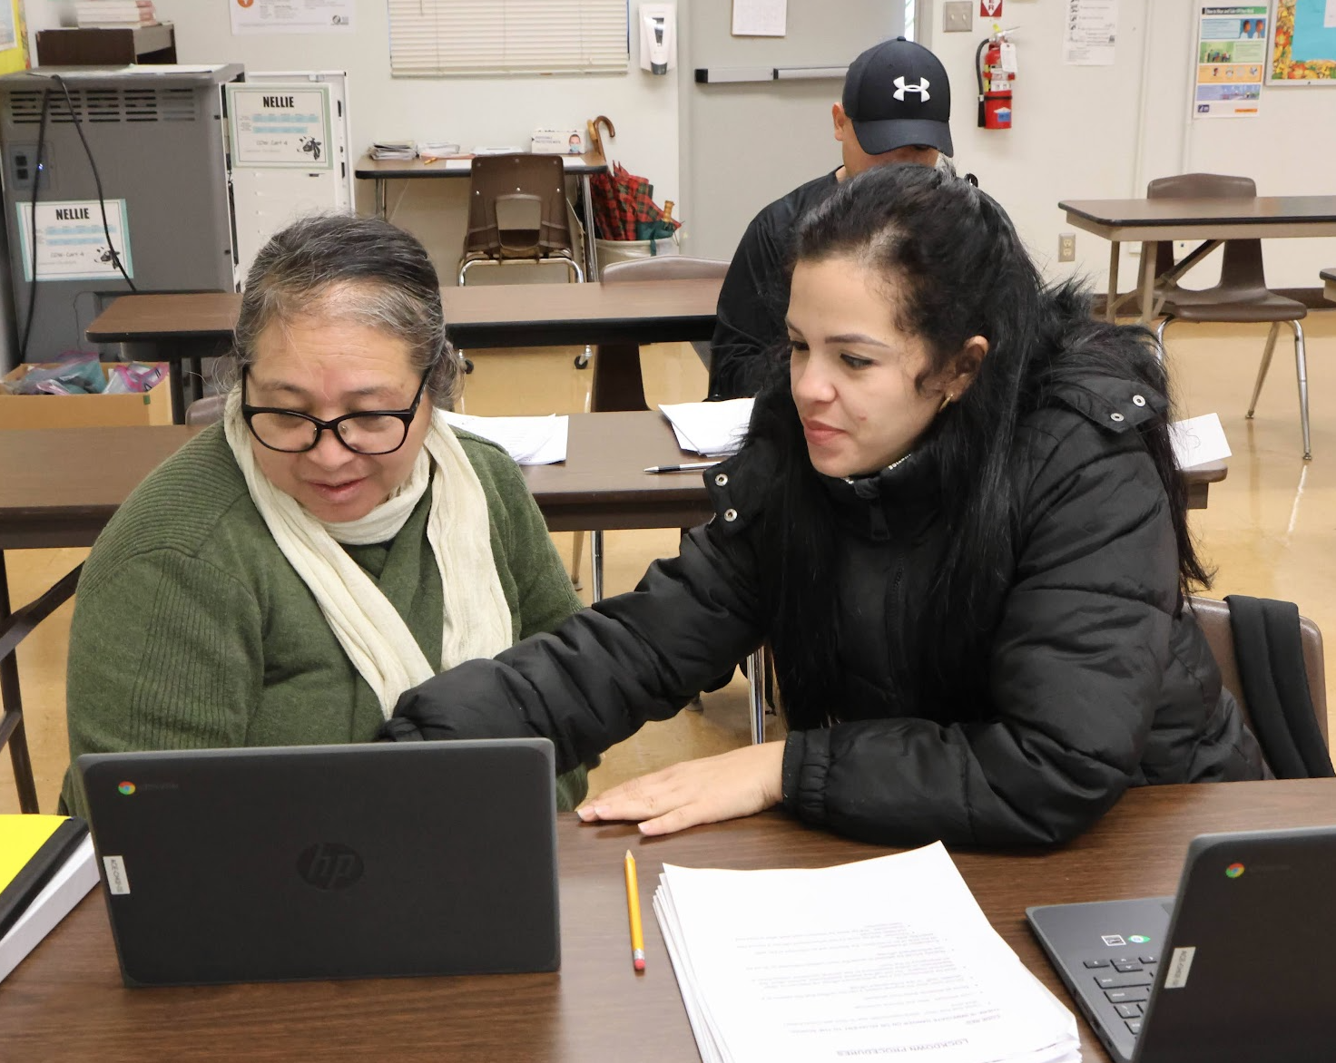
Digital Learning Implementation
Implementation Challenges
Students
  e.g., access to devices and connectivity
Educators
  e.g., professional development
Notes:
🕧 = 2-3 minutes
Discuss some of the common implementation considerations
Challenges in digital learning implementation include
access to devices and connectivity
digital literacy skills
managing multiple roles and responsibilities
and effective communication.
Other considerations for effective implementation include
robust infrastructure
appropriate funding
professional development
technical support,
and time (to implement, monitor, and improve of digital learning programs)
🗣️ Facilitation tip. These slides are mostly “lecture” style as content is presented. But on each slide, it’s okay to also pose questions to solicit current thinking and understanding.
For example: “What challenges are you experiencing with implementing digital learning models?”
Allow participants to share their perspectives, and then use the speaker notes to add-to and/or deepen the conversation

Slide 9
Activity: Digital Tool Exploration
Activity Instructions
In groups:
Pick a scenario (presented on the following slide)
With your group, define which digital learning model makes most sense to support adult learners
Identify a digital tool that could be used within that model to significantly improve the learning experience
Share your thinking in the collaborative slide deck
Notes:
🕧 = 1 minute to explain the activity
📃 You can make a copy of the slide template below* and share an edit link to groups as a guide for the activity.
Explain the objectives of the activity
Understand the complexity and implications of common scenarios and challenges experienced by adult learners.
Apply the principles of digital learning to design inclusive and accessible learning experiences that effectively respond to those challenges.
Utilize a digital collaboration tool to share ideas and collaborate with peers.
Reflect on the importance of digital tools in supporting accessible and meaningful learning for adult students.
Briefly describe the process of the activity, including group formation, the role of digital collaboration tools, and the task to be accomplished.
Form into small groups.
Choose a scribe to take notes and a presenter to share group's findings.
Review the assigned adult education scenario (on slide 10)
Discuss and collaborate to develop a digital tools pitch:
What tool did you select?
Why did you select it?
How it can be used to support effective and inclusive digital learning.
Utilize the collaborative to visualize and share responses (template provided in slide 10 speaker notes).
Reflect on the activity and share findings with the larger group.
Links:
Slide Deck Template: https://docs.google.com/presentation/d/1Dnft8zB_LQUwfh59M_imaoJGDVgfNl_VnyCxfy3QYmo/copy

Slide 10
Common Scenarios
Scenario 1 | Scenario 2 | Scenario 3 | Scenario 4 | Scenario 5
Limited Digital Literacy | Limited Connectivity | Diverse Learning Needs | Balancing Work and Learning | Language Barriers
Guiding Questions
What are the specific needs of your learners in the scenario?
What is the appropriate balance between synchronous and asynchronous content?
Which digital tools might be most effective for the chosen digital model and scenario?
How can you ensure accessibility and equity in your learning design?
Notes:
🕧 = 25 minutes to work with groups on potential solutions
📃 You can make a copy of this slides (https://docs.google.com/presentation/d/1Dnft8zB_LQUwfh59M_imaoJGDVgfNl_VnyCxfy3QYmo/copy) template and provide to groups as a guide for the activity.
Speaker notes start here 👇
Introduce each scenario.
Explain the challenge in adult education each scenario represents.
Share a Google Slide with groups that include one scenario per slide, including space for where responses can be added.
Briefly touch on the implications and potential impact of this challenge in a digital learning setting.
Limited Digital Literacy: You are tasked with designing a digital learning experience for a group of adult learners who are new immigrants. They have limited digital literacy skills and are not familiar with most digital learning tools.
Limited Connectivity: You need to create a digital learning experience for a rural community where high-speed internet access is sporadic and not all learners have regular access to a personal computer.
Diverse Learning Needs: You are creating a digital learning experience for a group that includes learners with diverse abilities. Some learners have physical disabilities, and others have learning disabilities that impact their reading comprehension and ability to process information.
Balancing Work and Learning: Your learners are primarily working adults who are returning to school to further their education. They have full-time jobs and family responsibilities, limiting the time they can devote to learning.
Language Barriers: The adult learners you are teaching are English language learners (ELLs). They are highly motivated but struggle with language barriers when using English-based digital learning tools and platforms.
Provide guiding questions to help support the conversation. Example questions might include:
What are the specific needs of your learners in this scenario?
What is the appropriate balance between synchronous and asynchronous content?
Which digital tools might be most effective for this scenario?
How can you ensure accessibility and equity in your learning design?
🗣️ Facilitation tip. The scenarios and guiding questions are also provided in the Slides template, so direct participants to the appropriate slide and encourage groups to use the template to guide the conversation and organize their response to share with the full group at the end of the activity.
If groups are struggling, consider sharing one potential solution from the speaker notes on slide 11 to model what kind of planning process we are trying to develop:

Slide 11
Potential Solutions
Scenario 1 | Scenario 2 | Scenario 3 | Scenario 4 | Scenario 5
Limited Digital Literacy | Limited Connectivity | Diverse Learning Needs | Balancing Work and Learning | Language Barriers
Notes:
🕧 = This is a support slide for the facilitator to reference while providing support to help guide the group activity.
Project the template on screen and have each group briefly discuss their strategy and highlights from the conversation.
If groups are struggling, consider sharing one potential solution from the following list just to model what kind of planning process we are trying to develop:
Limited Digital Literacy: For a group of immigrants with limited digital literacy, educators might choose a simple and intuitive Learning Management System (LMS), like Google Classroom, due to its simplicity and integration with other Google tools. The educators could create a series of short, engaging tutorial videos (using a tool like Loom* demonstrating how to use the LMS and other essential digital tools. These could be translated into native languages and viewed asynchronously, allowing learners to progress at their own pace.
Limited Connectivity: For learners in a rural community with inconsistent internet access, the plan might involve a blended learning approach. Digital materials could be distributed on USB drives for offline use. Time can also be spent on walking through downloading and curating/storing/organizing digital content. Additionally, a mobile-friendly LMS, like Moodle, could be utilized as many learners may have more reliable access to mobile data than home broadband. The LMS could be used to host downloadable resources, activities, and assessments that can be accessed and completed offline.
Diverse Learning Needs: To accommodate learners with diverse abilities, digital learning experiences might feature a wide range of multi-modal content (e.g., video, audio, text) to support accessibility and inclusivity. Tools like Immersive Reader in Microsoft Word can support learners with reading difficulties. Platforms like Blackboard Ally* can help ensure that digital content is accessible. The plan could also include synchronous components with live closed captioning for the hearing impaired.
Balancing Work and Learning: For working adults, a flexible HyFlex model might be employed. This would allow learners to choose between in-person, synchronous online, and asynchronous online participation. Tools like Padlet could be used for asynchronous brainstorming and discussion activities, and Zoom for synchronous sessions. The use of an LMS like Canvas would enable learners to access materials and collaborate with classmates at their convenience.
Language Barriers: For ELLs, the plan might involve incorporating translation tools like Google Translate* into the digital learning platform. The educators might also choose to incorporate English language learning software like Rosetta Stone* or Duolingo*. Visual aids, interactive activities, and multimedia content could be emphasized to support comprehension. Synchronous sessions could incorporate breakout rooms for smaller, more comfortable discussion groups with peer support.
Consider also sharing potential tech tools that can be considered as part of the activity:
GCF Global
Single Sign-On
Canvas
Immersive Reader
Padlet
Duolingo
…etc.
Links:
Loom: https://www.loom.com/
Blackboard Ally: https://ally.ac/
Google Translate: https://translate.google.com/
Rosetta Stone: https://www.rosettastone.com/
Duolingo: https://www.duolingo.com/

Slide 12

Sharing Solutions
Questions to consider
What was the most challenging aspect of creating your digital learning experience, and why?
What digital tools did you choose and why? How do these tools enhance the learning experience?
How did your group balance synchronous and asynchronous elements?
Notes:
🕧 = 5 minutes for small group reflection, then 10 minutes for sharing with the full group.
Each group will select a representative to share their digital learning experience design with the whole class.
Using the share screen feature, the group’s can discuss their design, explaining their choices and how they addressed the scenario.
After each presentation, there will be time for Q&A and feedback from other participants and the facilitator.
Questions that groups can reflect on as they share their example include:
What was the most challenging aspect of creating your digital learning experience, and why?
What digital tools did you choose and why? How do these tools enhance the learning experience?
How did your group balance synchronous and asynchronous elements?
🗣️ Facilitation tip: Note that groups do not need to answer every question but can rather pick and choose those that seem most relevant for offering insight into their thinking and planning process.

Slide 13

What’s Next?
Chapter 5 of the Digital Learning Guidance provides more details and discussion of key principles
The self-paced course on the OTAN website includes a multiple-choice quiz and extension activities
Continue finding opportunities to learn from each other as we explore best practices in digital age adult learning
Notes:
🕧 = 5 minutes
Review key concepts from the chapter and offer ideas on how to continue learning after today’s session.
Understanding and Implementing Digital Learning Models
Explored the concepts and importance of synchronous and asynchronous learning in digital education, explaining their benefits and drawbacks.
Delved into key considerations for planning and implementing digital learning experiences, focusing on accommodating diverse learners' needs and ensuring accessibility.
Discussed the importance of continuous iteration and improvement in digital learning experiences to empower adult learners in a digital world.
Addressing Equity and Accessibility in Digital Learning
Highlighted the importance of ensuring equity and accessibility in digital learning, offering strategies to address potential barriers.
Emphasized the importance of providing digital literacy support to students, which can involve linking to online tutorials or starting lessons with a digital literacy overview.

